Slide 1
Musical Chord Progression Analysis
Thomas Burless
John Culhane
Mario Iglesias
Janice Javier
Morgan Tosini

Slide 2
Purpose: Identify the most popular Chord Progressions
We are looking at the some of the more popular songs in history through different genres and seeing if there are specific chord progressions that are used in these songs
Do people like to listen to a certain chord progression?
Is there a certain part of a song that a popular chord progression shows up?
Which chord progressions do we see the least in popular music?
Is there a difference between popularity and listens of a song and how does chord progression factor in?
Most popular chord progressions and genre by country?

Slide 3
Musical Chord Progression
A series of chords played in a sequence. Each chord is a harmonic function within a key, which means to compare the chord to the tonic of the key
Chord progressions help to establish a harmonic path for the melody to surf on top of
Chord progressions are the foundations for some music styles such as Rock, Jazz, and Blues
In pop music, chord progressions may unfold over a line of lyrics then loop back; whereas in jazz a chord progression may never loop in a song. We will see examples of this later on

Slide 4
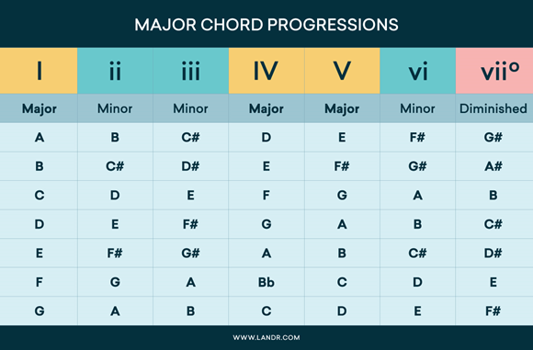
Different Types of Chord Progressions

Slide 5
Our Predictions
I V VI IV will be the most popular chord progression because it makes up many popular songs over the last 50 years
Chord progression popularity will differ by country and so will genre
Artists do release certain songs based off of chord progression that they produce to try to predict which will be the most popular

Slide 6
Application Programming Interfaces
Spotify’s API
Last.FM
Pylast libraray
HookTheory

Slide 7
Data Exploration
Spotify
Top 200 list by Country
Popularity Metric
Release Date
Last.fm
Track.getInfo
topTags
Search
HookTheory
Trend/songs

Slide 8
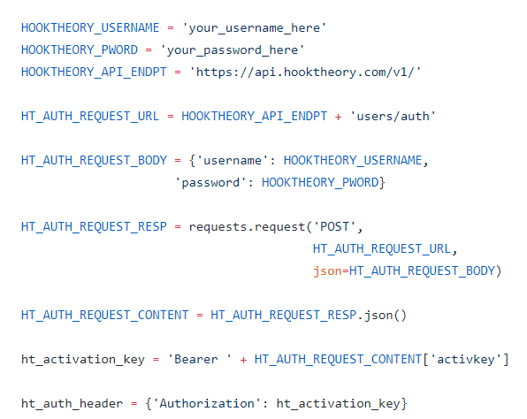
Query Examples
https://github.com/jhamer90811/chord_progression_assistant/blob/master/main.py

Slide 9
Data Analysis
Over 13,000 songs
75 different chord progressions for 3 chord
253 different chord progressions for 4 chord
818 different chord progressions for 5 chord
In each of the top chord progressions, the area it is used most in a song is in the chorus
13%( the highest percentage) of the progressions were 1,5,6 for 3 chord
Chords 2,3, and 7 and 5-part progressions show greater representation in “instrumental” songs/parts-of-songs than in chart-toppers or pop music at large

Slide 10
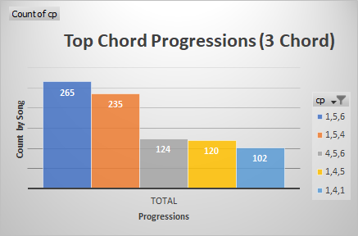
Data Analysis: Table 1.1: 3 Chord

Slide 11
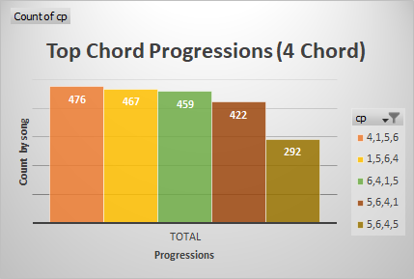
Data Analysis: Table 1.2: 4 Chord

Slide 12
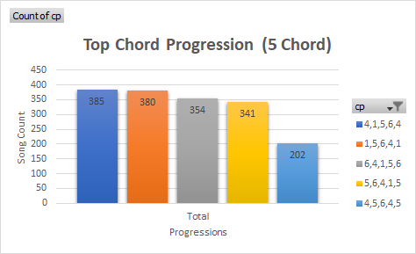
Data Analysis: Table 1.3: 5 Chord

Slide 13
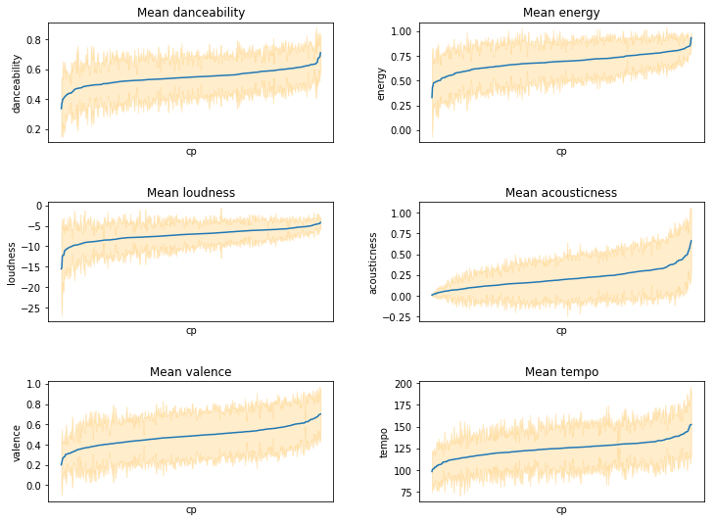
Data Analysis: Table 2

Slide 14
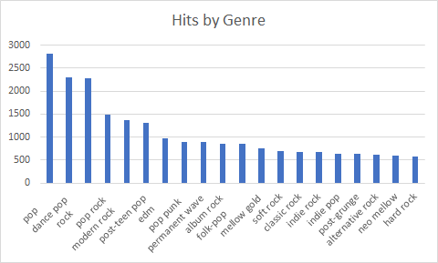
Data Analysis: Table 3

Slide 15
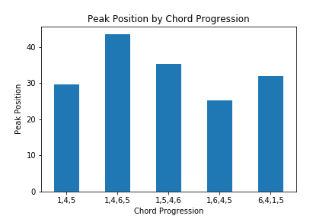
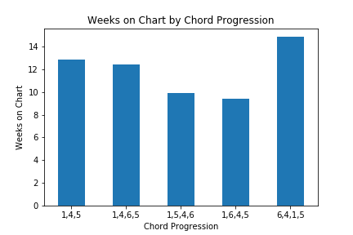
Data Analysis: Table 4

Slide 16
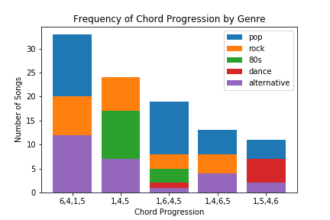
Data Analysis: Table 5

Slide 17
Data Analysis: Table 6.1

Slide 18
Data Analysis: Table 6.2

Slide 19
Data Analysis: Table 6.3

Slide 20
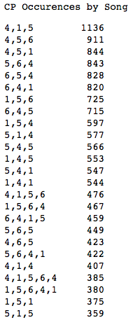
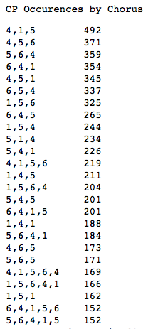
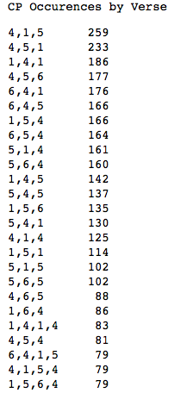
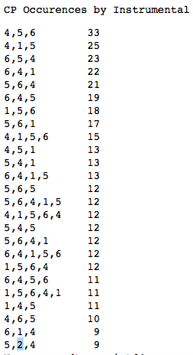
Data Analysis: Song Section/Type Comparisons

Slide 21
Top Progression Examples
1,4,1 - https://www.youtube.com/watch?v=MWTBxPudQig
1,4,5 - https://youtu.be/lXcX5llJeko?t=39
1,5,4 - https://youtu.be/E1mU6h4Xdxc?t=69
1,5,6 - https://youtu.be/ZoG5jJ3E8rg?t=11
4,5,6 - https://youtu.be/rYEDA3JcQqw?t=44

Slide 22
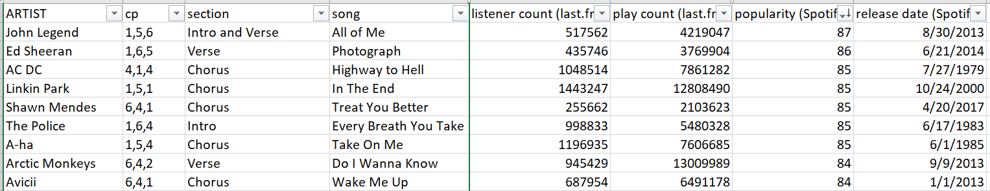
Popularity Top Ten Surprise

Slide 23
Data Surprises
HookTheory had a good amount of Japanese songs, as we thought it would be very westernized
The most listened to song, based on data from Last.FM was “Smells Like Teen Spirit” by Nirvana(2,108,507) and “Mr.Brightside” by the Killers(2,025,975)
Using Spotify’s popularity algorithm, the most popular songs were “All of Me” by John Legend(87) and “Photograph” by Ed Sheeran(86)
Chord Progression 1,5,6 was overwhelming the most used in 3 chord, but not the same differentials in 4 and 5 chord
There were many more variations on 5 chord than on 3 and 4 chord

Slide 24
Challenges
The data from HookTheory was our anchor, but it was not as robust as Spotify or Last.FM
HookTheory was more of a “Greatest All Time” list whereas Spotify and Last.FM were more recent hits, though they did have all the songs in HookTheory
Last.FM does not have a genre category, so we had to use getTags, which gave more than just genre, so that had to be cleaned
Converting the roman numerals to lowercase when appropriate to constitute minor chords
Dealing with duplicates
What metric to use for scaling chord progressions
Getting song data by country proved difficult, especially trying to merge

Slide 25
Unanswered Questions
What are the most popular chord progressions by country?
What are the most popular genres by country?
Do we see artists using the more popular chord progressions within the same song?
What is it about chords 1, 4, 5, and 6 that lends them so well to pop music.
Do artists try to release singles or album teases with certain popular chord progressions to boost anticipation and gain notoriety?

Slide 26



